Slide 1
Encryption Methods Using Thompson's Group base on the RSA Algorithm
Submitted by: Eden Mor, Yarik Vitovsky Supervisor: Robert Schwartz

Slide 2
Table of Contents:
RSA Algorithm – Page 3
Thompson's Group – Pages 4-6
Project Objective – Page 7
Bibliography – Page 8

Slide 3
RSA Algorithm
RSA is a deterministic public-key encryption system )no random encryption factors). The RSA algorithm is based on multiplying two large prime numbers, p and q, such that their product N serves as the public key. Encryption is performed by raising the message M to the power of e modulo N, where e and N are coprime:
Me ≡ C (mod N)
For decryption, the private key is used, where d is defined as the modular inverse of e modulo ϕ(N) (Euler's totient function):
ed ≡ 1 (mod ϕ(N))
where ϕ(N) is defined as:
ϕ(N) = (p-1)(q-1)
Which calculates the original message:
C^{d} ≡ M^{ed} ≡ M (mod N)
The reliability of RSA stems from the practical difficulty of factorization, which is an open problem in number theory [4].

Slide 4
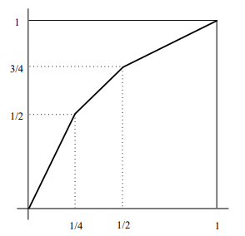

Thompson’s group
The Thompson group F is defined as the group of piecewise linear transformations of the interval [0,1]. These transformations are homeomorphisms (bijective and continuous mappings) that preserve orientation.
The slope in each linear segment is always a power of 2, and the breakpoints (the points where the slope changes) are dyadic points of the form:
Where each transformation has a finite number of breakpoints.
A key property of this group is that it has no elements of finite order except the identity element[1].

Slide 5
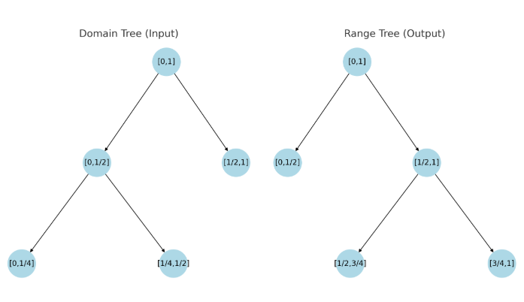
Each element in Thompson's group F can be represented by a pair of binary trees with the same number of leaves. These binary trees correspond to subdivisions of the interval [0,1] into subintervals, where each leaf of a tree represents a subinterval.
The pair of binary trees describes a transformation by associating the leaves of one tree with the leaves of the other tree. This mapping implies that each subinterval from the first tree is linearly mapped to the corresponding subinterval in the second tree.
Using binary trees provides a visual and intuitive way to understand the structure of Thompson's group and how its transformations divide and recombine the interval [0,1].

Slide 6



Another representation of Thompson's group F is through word form:
This infinite presentation is characterized by several properties that enable message encryption through group operations, for example:
Thus, we obtain the encryption for the message M:
Such that the encrypted message C is:
Every element in F is constructed from two generators and only two relations (commutator equations).

Slide 7
Project Objective
In 2005, the article "Thompson’s Group and Public Key Cryptography" [5] was published, presenting a public-key encryption protocol based on Thompson's group.
The goal of the project is to attempt to develop a new public-key encryption protocol based on Thompson's group, leveraging its unique properties and RSA-based cryptography.
By utilizing the distinctive characteristics of the group, we aim to identify unique operations through which a private key can be developed. This private key will be responsible for decrypting the encrypted message while being difficult to break.

Slide 8
Bibliography:
Introduction to Thompson’s group F – Jose’ Burillo
Introduction to Thompson’s group – Ken Brown, Cornell University
When Is the Multiplicative Group Modulo n Cyclic? Aryeh Zax, November 30, 2015
The Jewish Encyclopedia - https://www.hamichlol.org.il/RSA
Thompson’s group and public key cryptography – Vladimir Shpilrain and Alexander Ushakov, Department of Mathematics, The City College of New York, New York, NY 10031

